Slide 1
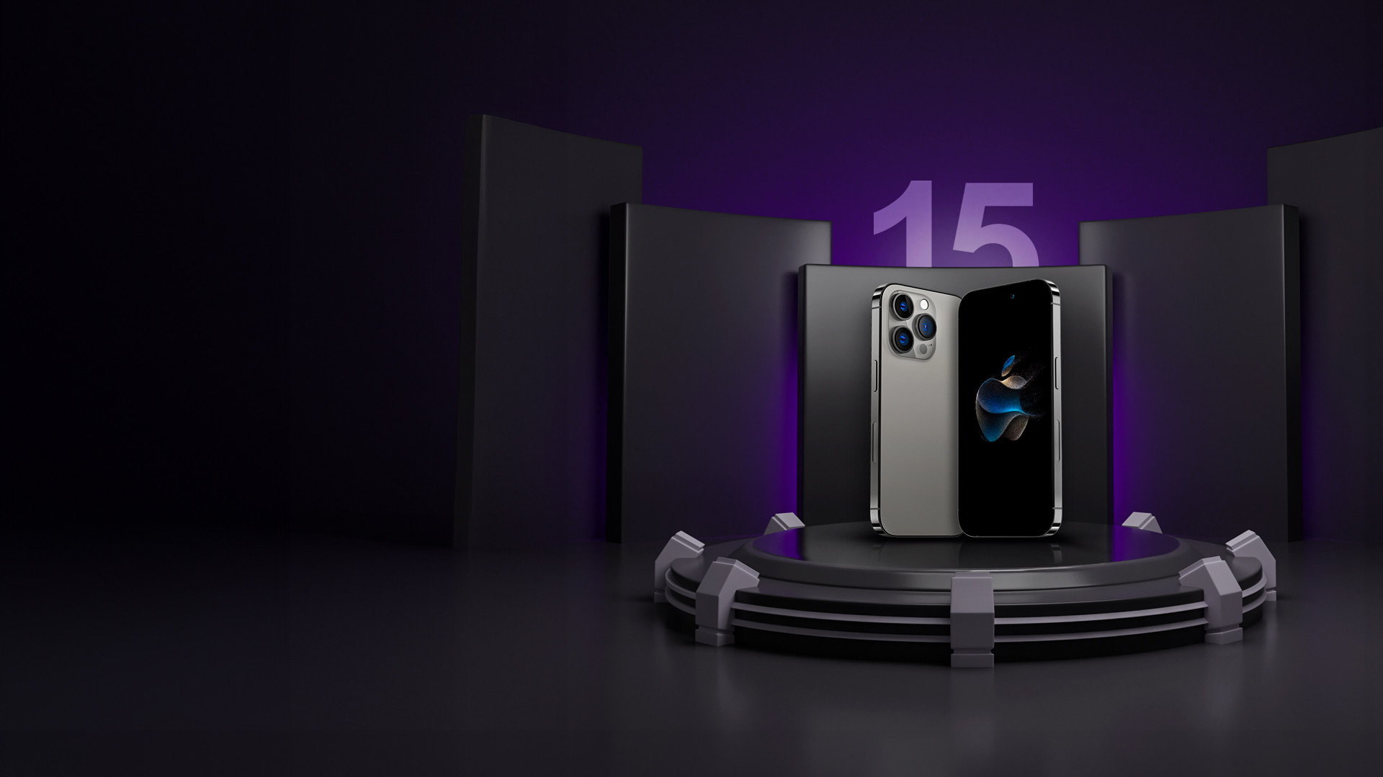

Apple Inc.
iPhone 15
The Best iPhone Ever

Slide 2
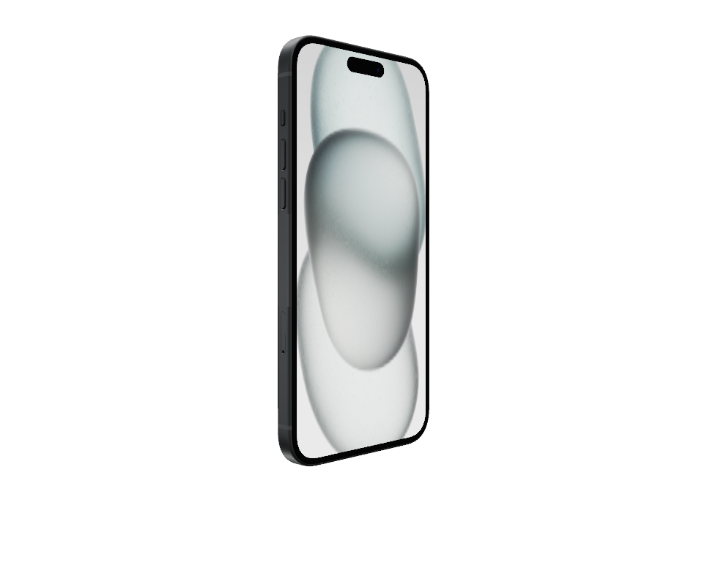
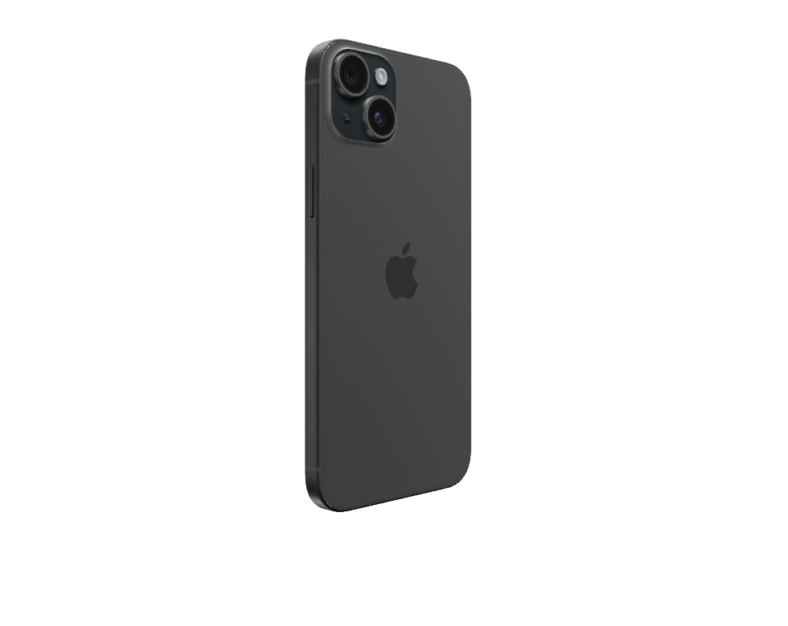
Introductory Price
The innovative new design features back glass that has colour infused throughout the material. A custom dual-ion exchange process for the glass and an aerospace-grade aluminium enclosure help make iPhone 15 incredibly durable.
iPhone 15 Rs.79,000/-
iPhone 15 Plus Rs.89,900/-

Slide 3
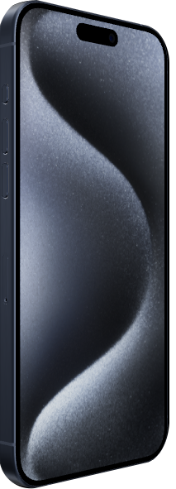
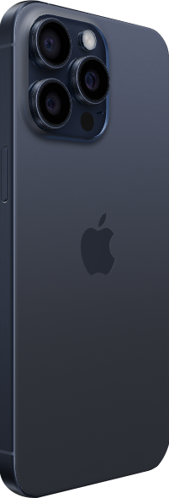
Introductory Price
The innovative new design features back glass that has colour infused throughout the material. A custom dual-ion exchange process for the glass and an aerospace-grade aluminium enclosure help make iPhone 15 Pro incredibly durable.
iPhone 15 Rs.1,39,900/-
iPhone 15 Plus Rs.1,59,900/-

Slide 4
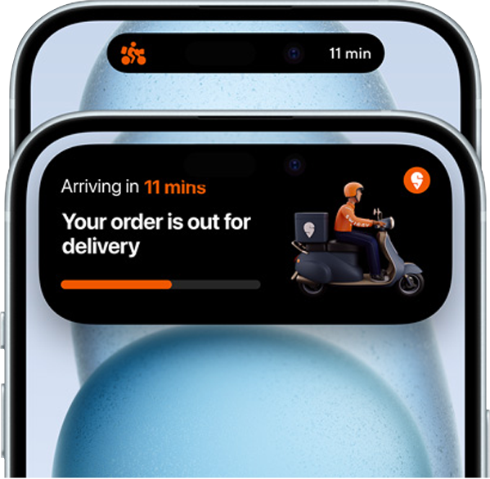
Dynamic Island
Dynamic Island can let you know if your flight is delayed, track your hike and tell you when your workout will end. And new apps are added all the time, so it keeps getting more and more helpful.
An
Island
for You
The Dynamic Island is able to display content that's running in the background, such as timers and music controls, it shows interactions like ‌Face ID‌ unlocking, Apple Pay payments, incoming phone calls, and more. It is interactive, you can tap into it to expand it.

Slide 5
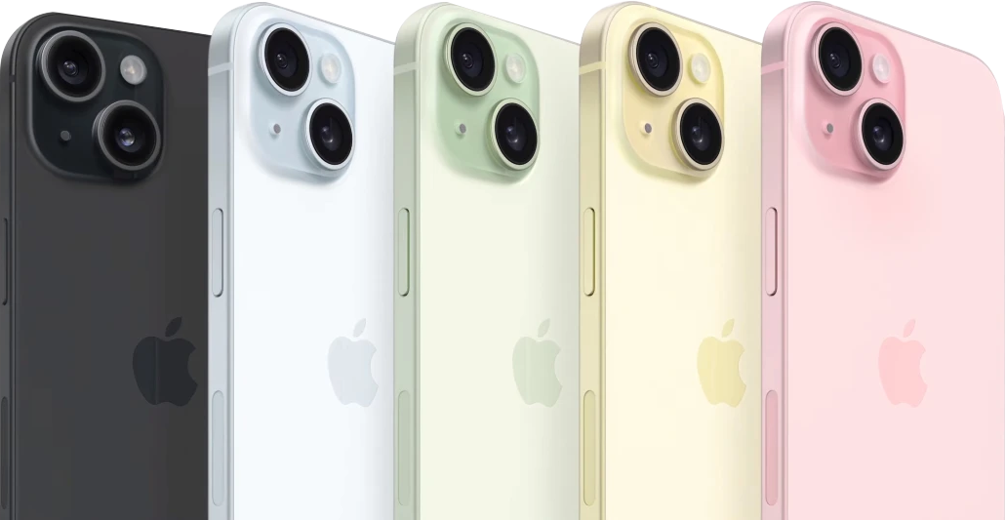
In Five
Amazing Colours
Queen Pink
Pearl
Pastel Gray
Light Gray
Onyx

Slide 6
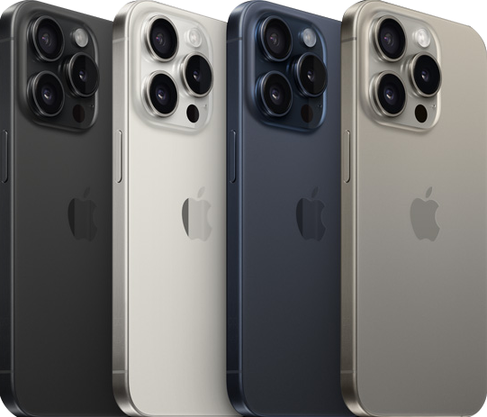
In Four
Different Colours
Timberwolf
Charcoal
Shadow Gray
Grullo

Slide 7
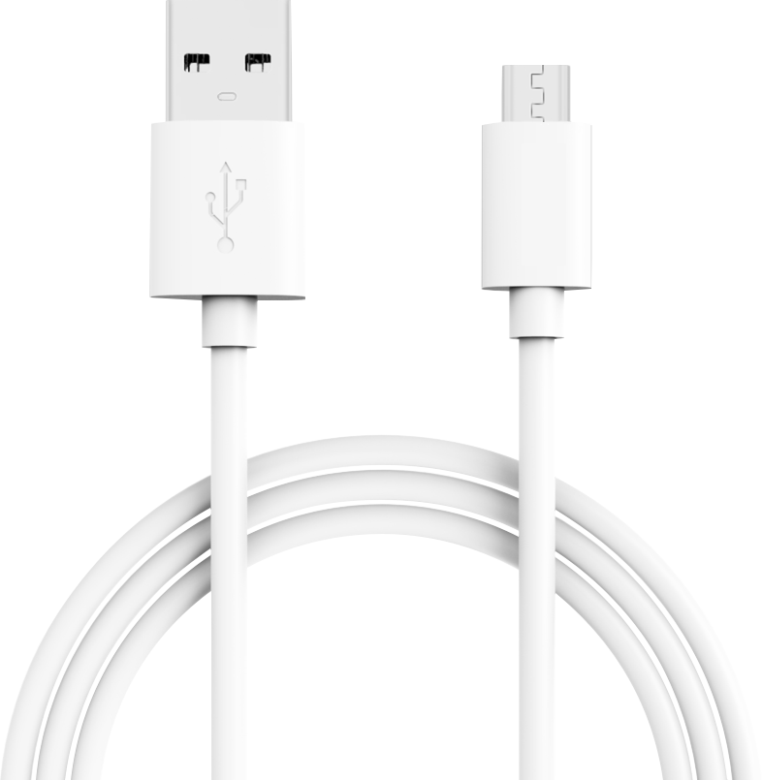
USB-Compatible
Faster Charging Speed
Faster Data Transfer Speed
One Charger for All
The new USB-C connector lets you to charge your Mac or iPad with the same cable you use to charge iPhone 15. You can even use iPhone 15 to charge Apple Watch or Air Pods. Bye-bye, cable clutter.

Slide 8


Apple A16 Bionic a 6-core chipset and is manufactured using a 4-nanometer process technology. It has 2 cores Everest at 3460 MHz and 4 cores Sawtooth at 2020 MHz
World's Most Powerful Processors
A17 Pro will feature a 6-core CPU, 6-core GPU and 6 GB of LPDDR5 RAM and power the upcoming iPhone 15 Pro and iPhone 15 Pro Max/iPhone 15 Ultra.

Slide 9
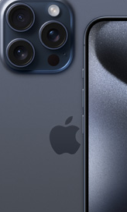


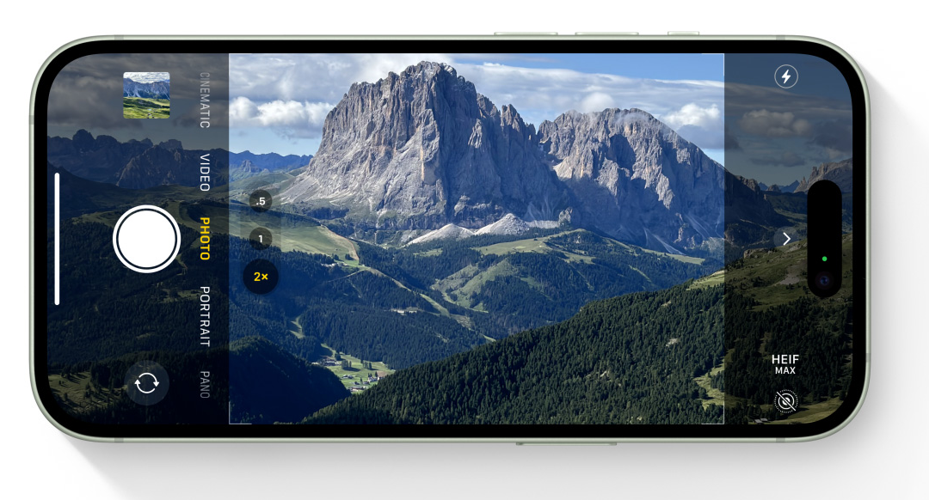
Ceramic
Shield
[ 24 mm ]
[ 28 mm ]
[ 35 mm ]
Pro Motion
Always-on Display
All day battery life
5x
Telephoto on pro max
Spatial
Video
Wi-fi-6E
And Thread
Next Generation Portraits
High End Gaming

Slide 10
Thank You

Slide 11
Instructions for use
You must credit Slidechef in order to use this template
What you are allowed to do :
Modify this template
Use it for personal or commercial projects
What you are not allowed to do :
Offer Slidechef templates for download
Sublicense, sell or rent any Slidechef content
Distribute Slidechef content unless it has been authorized
Include Slidechef content in an online or offline file
Acquire the copyright of Slidechef content

Slide 12

Slide Chef

